Slide 1


ChowHub
Streamlining Restaurant Management
By
Mostafa Hasanalipourshahrabadi
Tingchen Tsao
Lily Huang
Furkan Bas
Saad Ghori

Slide 2

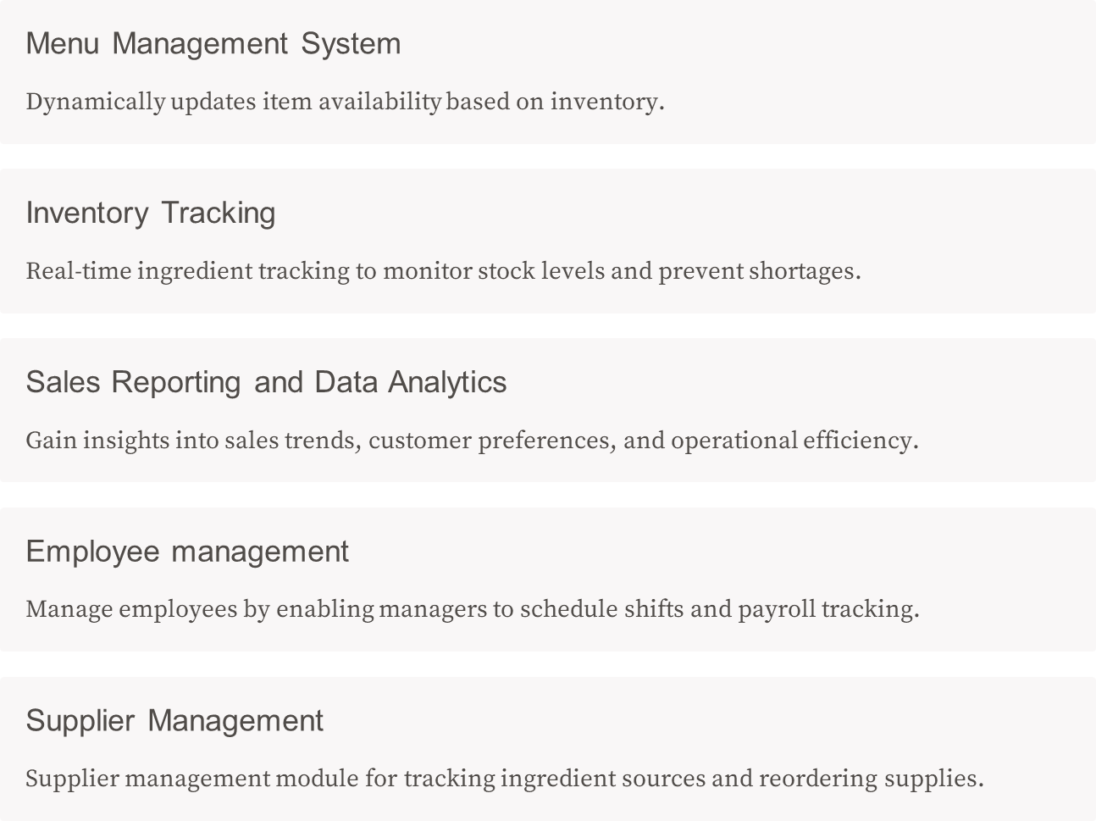
ChowHub:
The All-in-One Solution

Slide 3

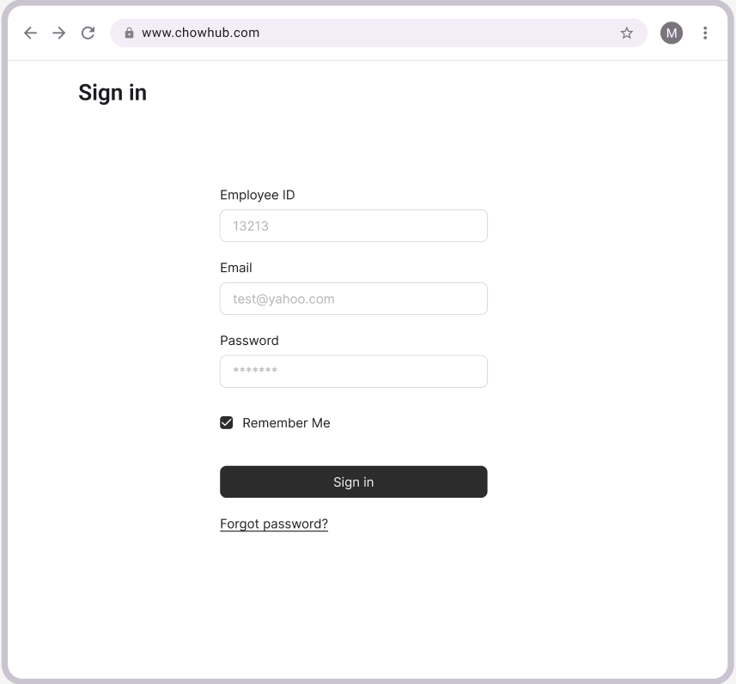
User authentication with role-based access

Slide 4

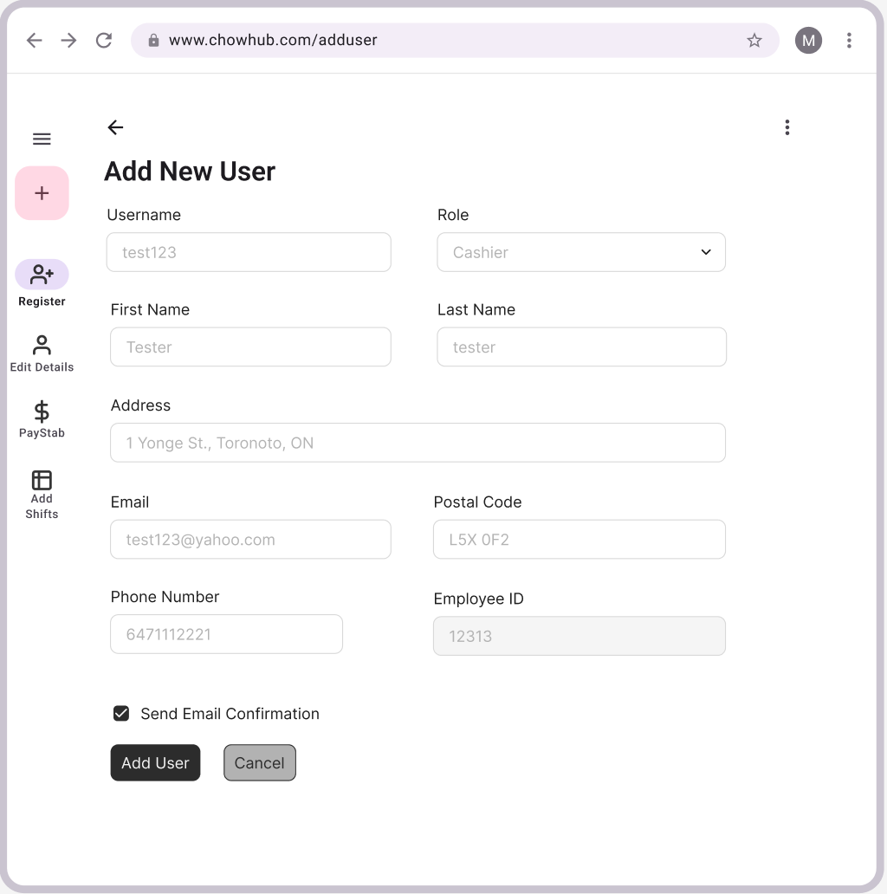
Employee Management:
User Registration

Slide 5

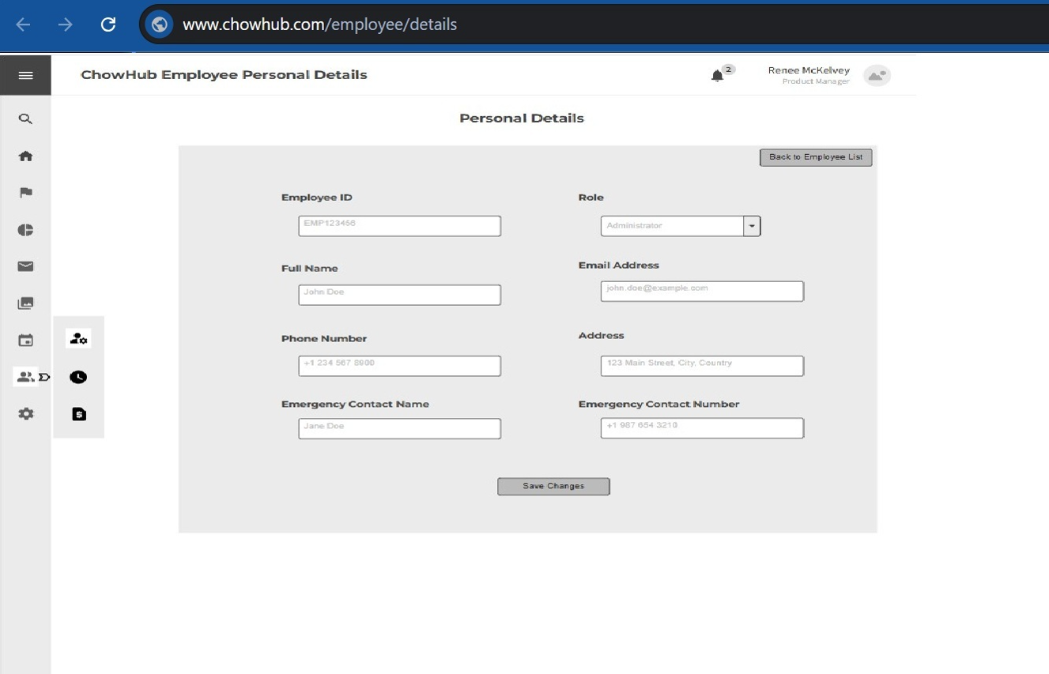
Employee Management:
Edit Personal Details

Slide 6
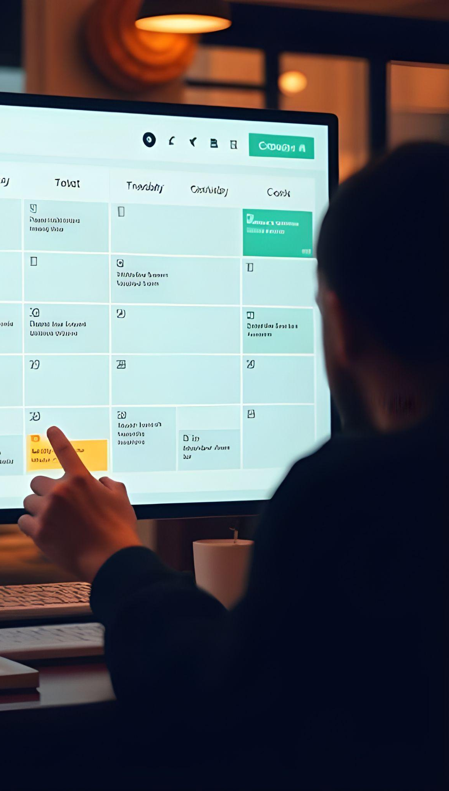
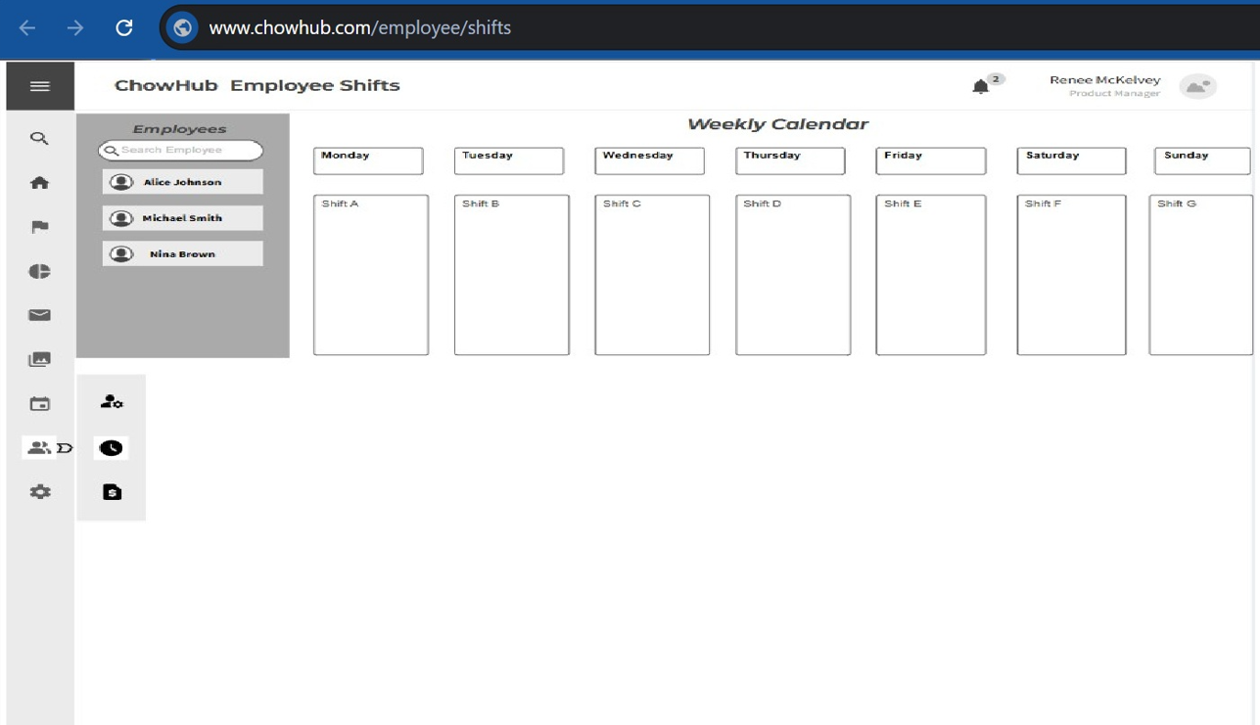
Employee Management:
Shift Schedule Calendar

Slide 7

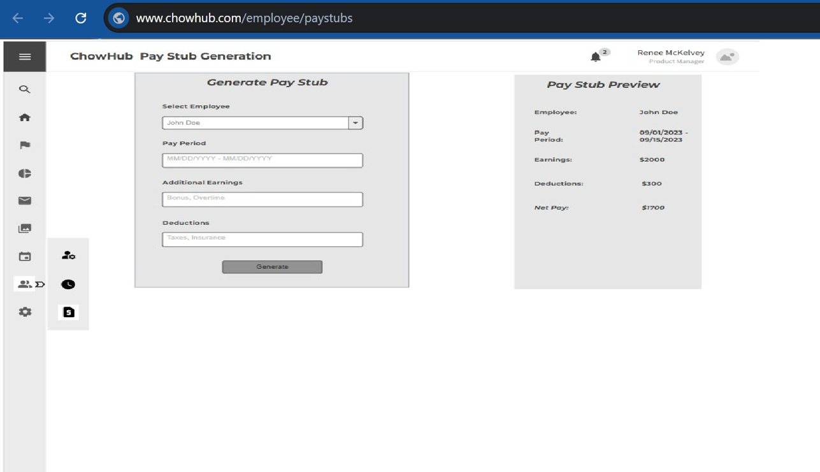
Employee Management:
Pay Stub Generation

Slide 8

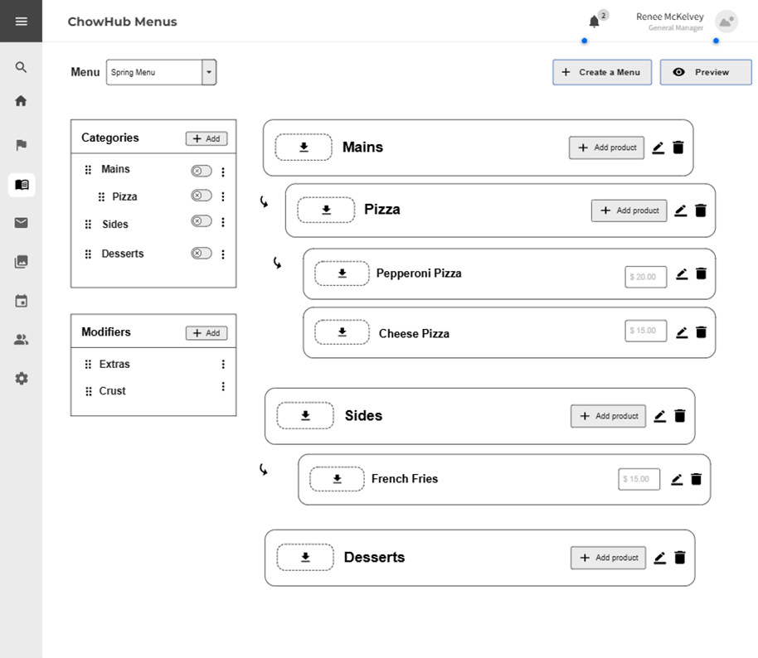
Menu Management:
Creating Menu

Slide 9

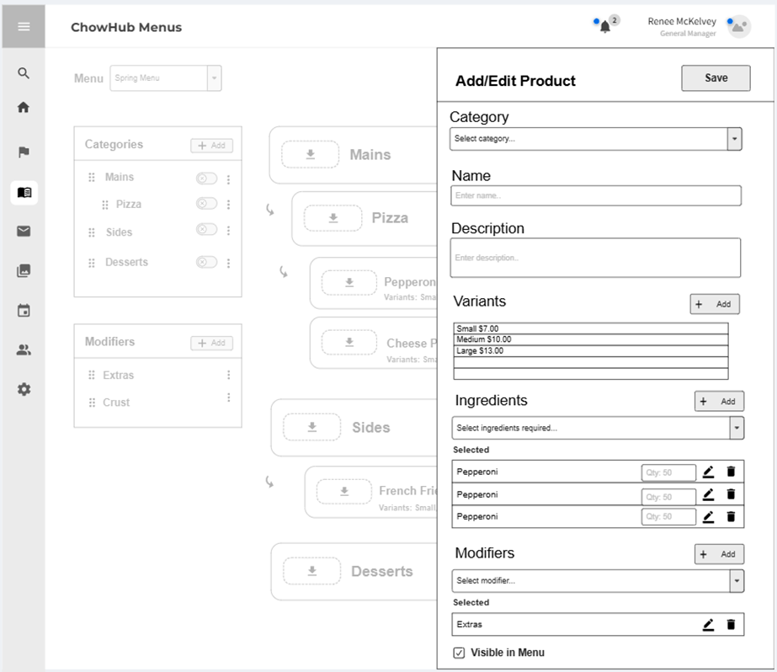
Menu Management:
Add/Edit Product

Slide 10

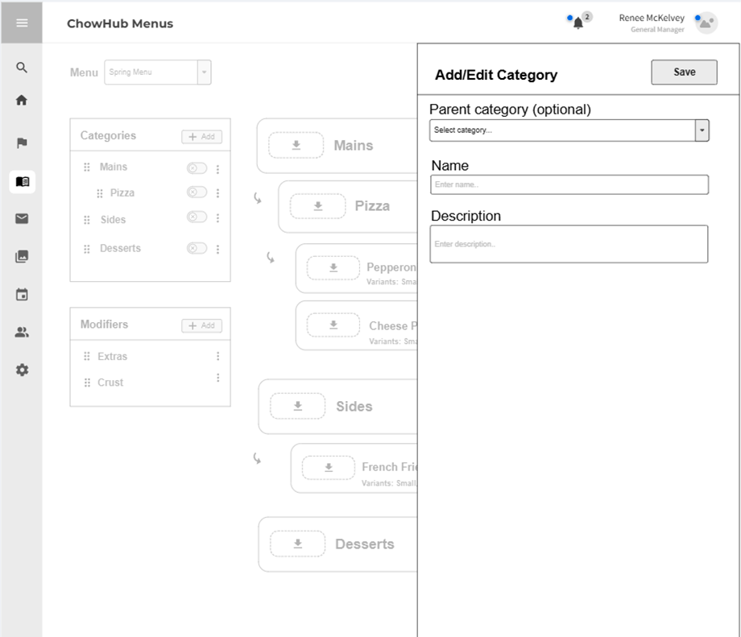
Menu Management:
Add/Edit Category

Slide 11


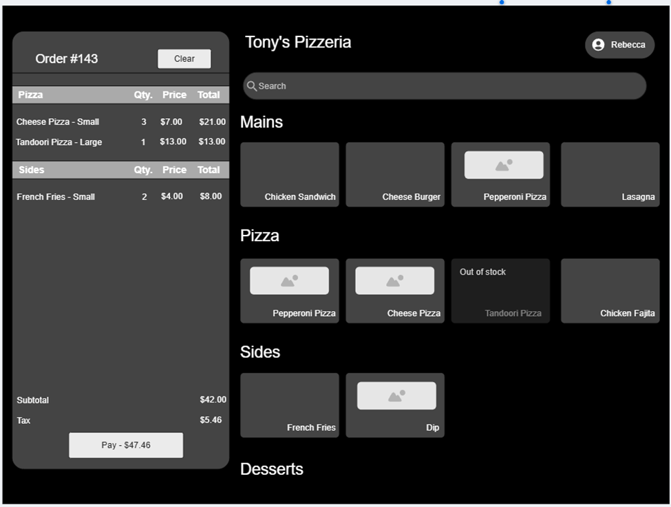
Order Placement: Main Screen

Slide 12

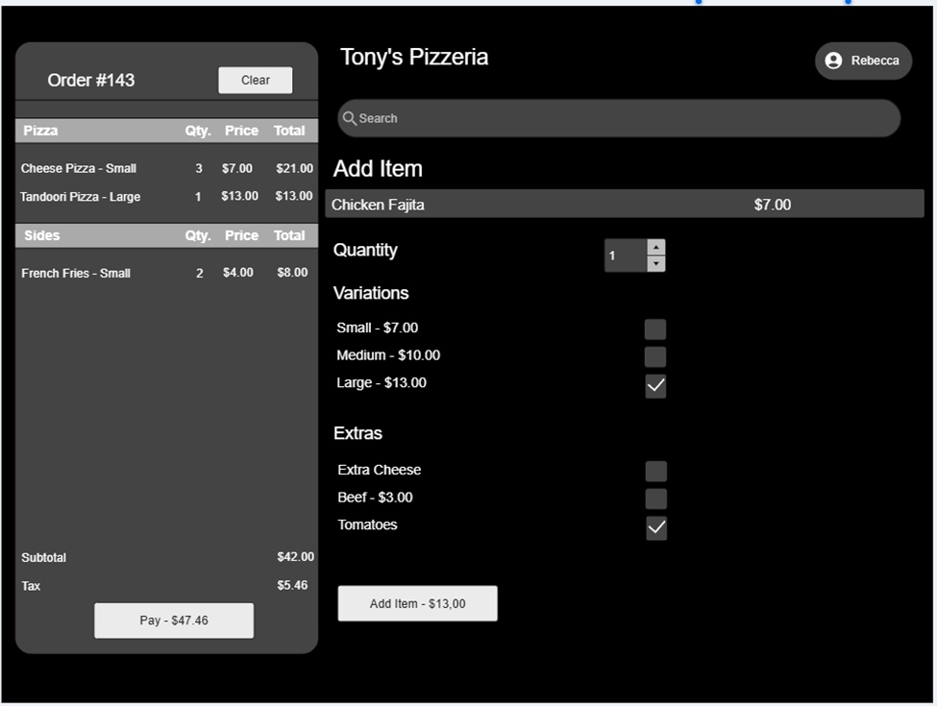
Order Placement: Adding Items to Order

Slide 13

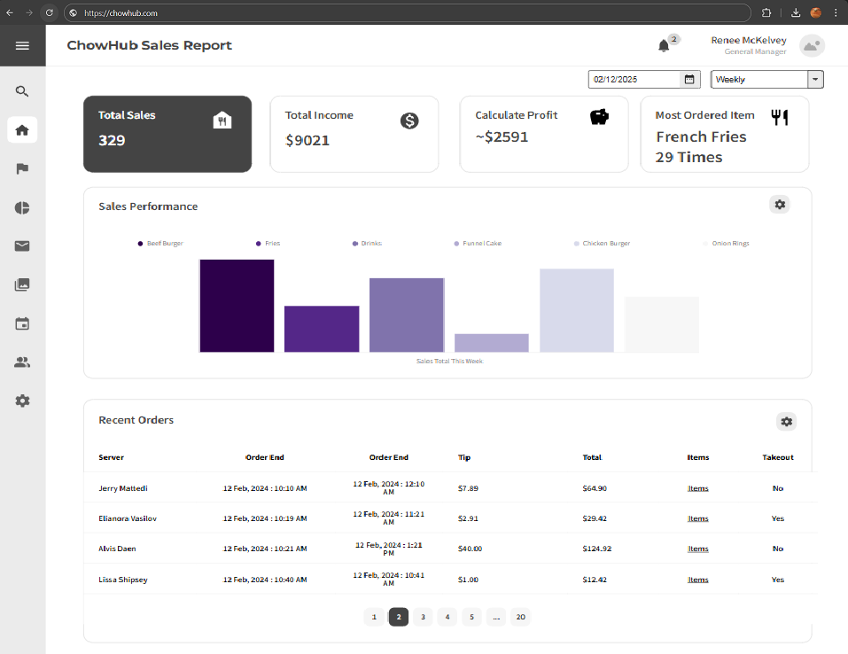
Sales Report

Slide 14

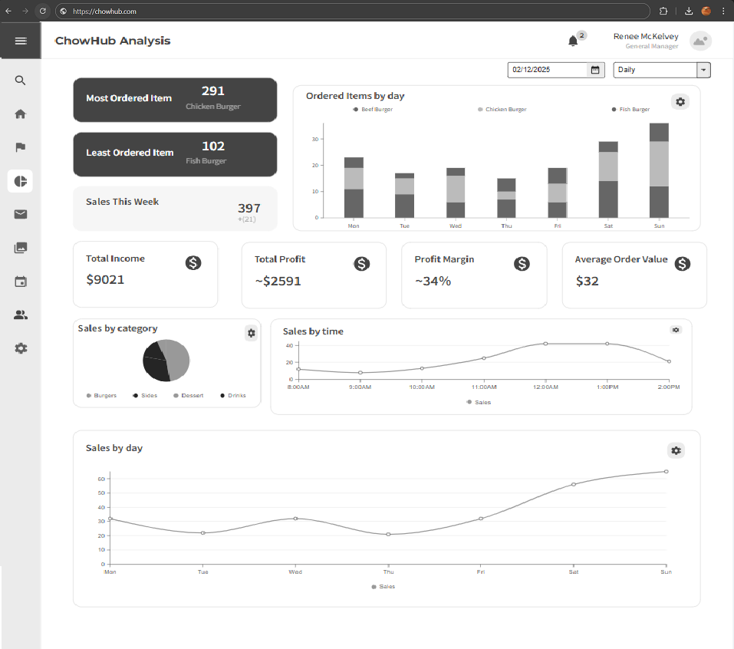
Sales Analytics

Slide 15

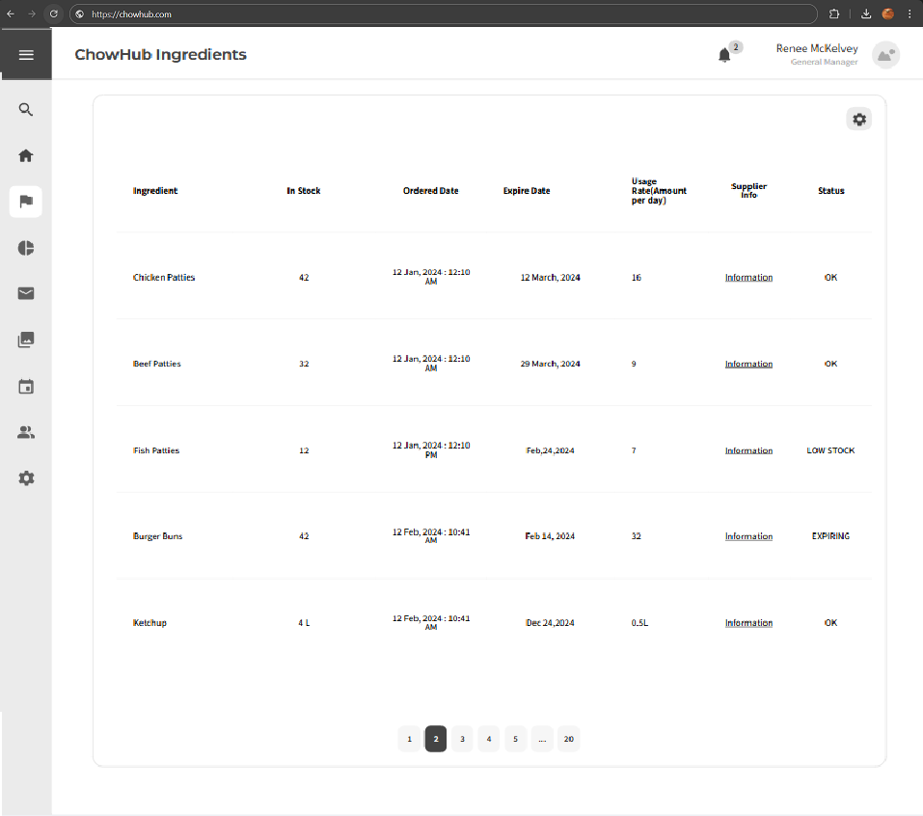
Ingredient Management

Slide 16

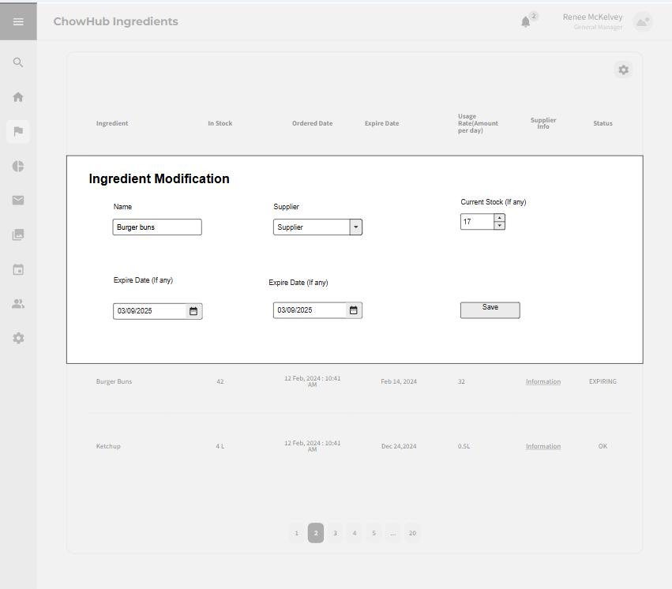
Ingredient Management

Slide 17
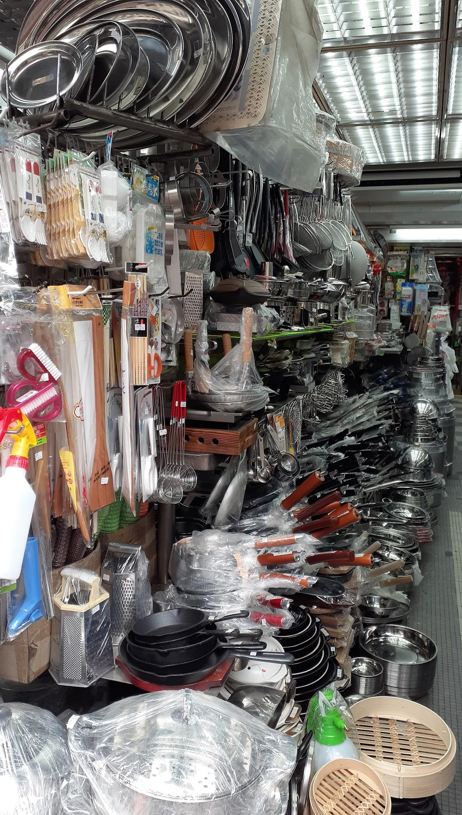
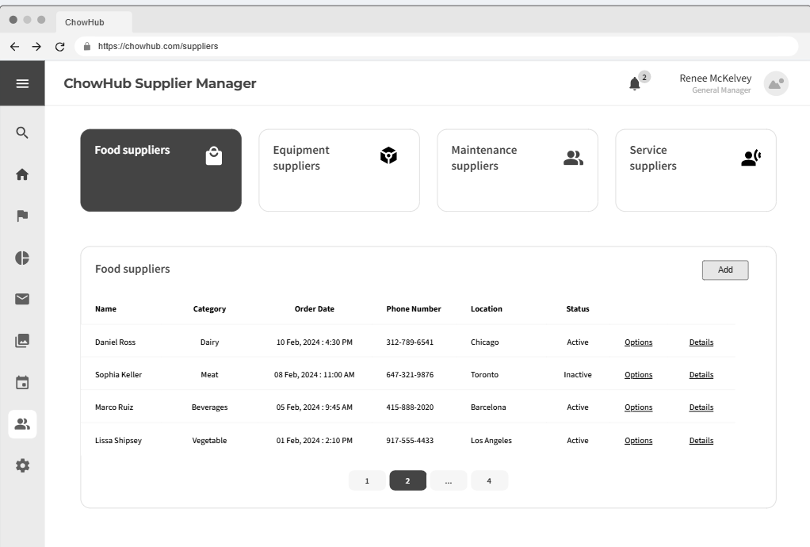
Supplier Management:
Adding supplier

Slide 18

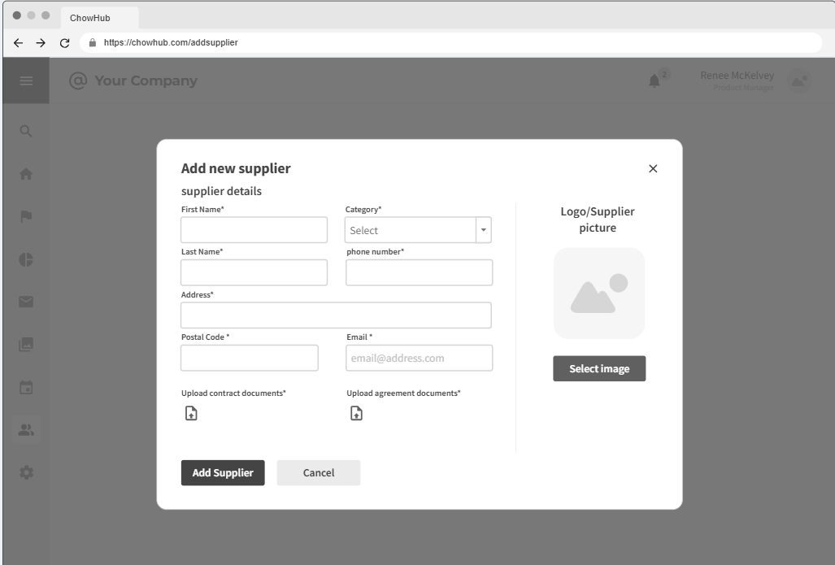
Supplier Management:
Adding supplier

Slide 19


Supplier Management:
Restock Request to Supplier

Slide 20
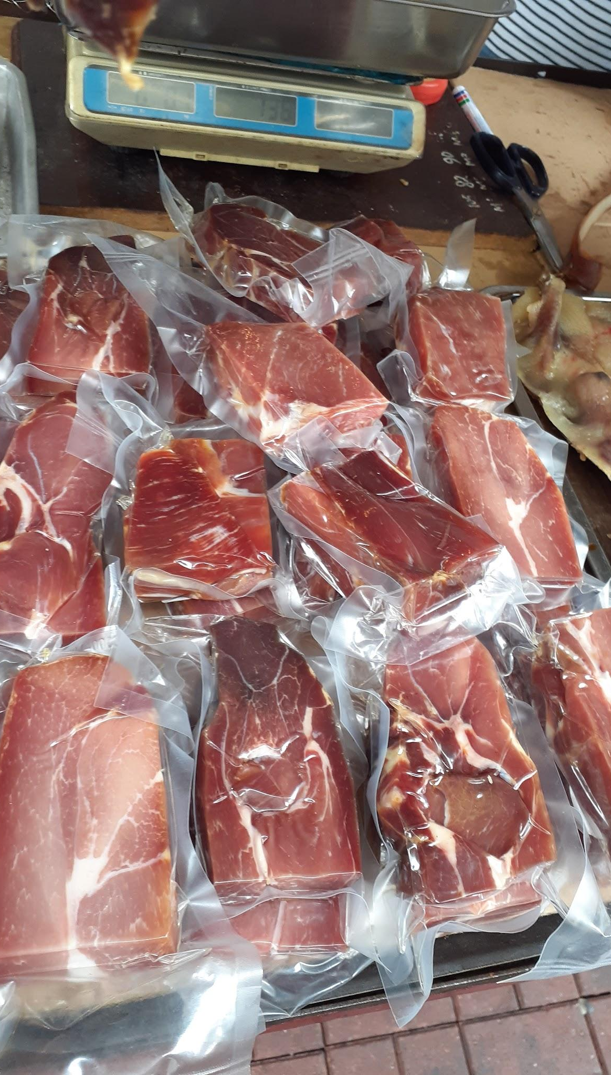
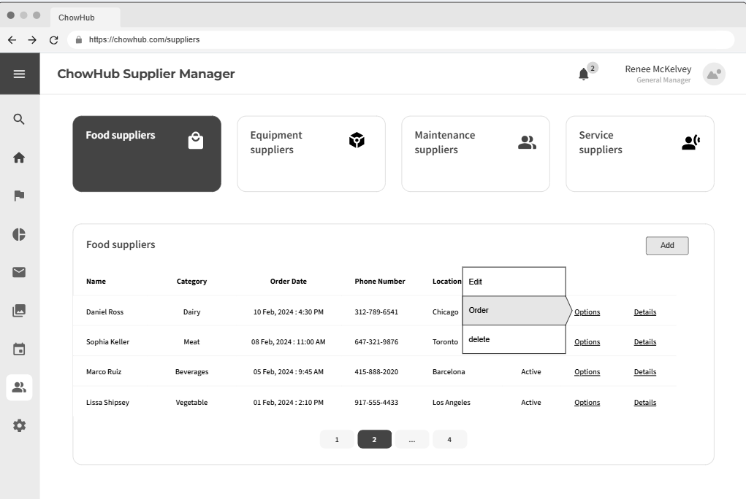
Supplier Management:
Restock Request to Supplier

Slide 21
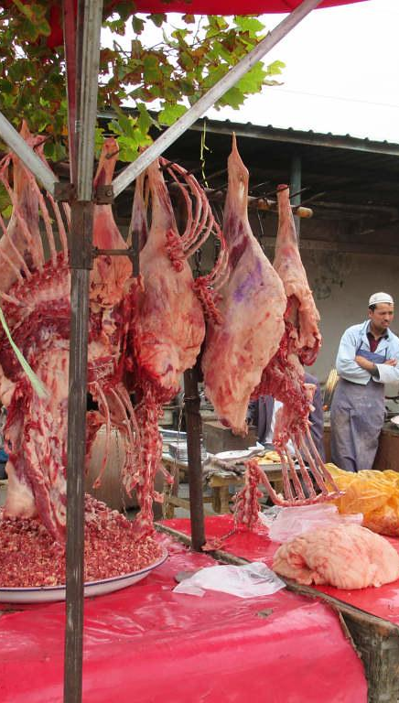
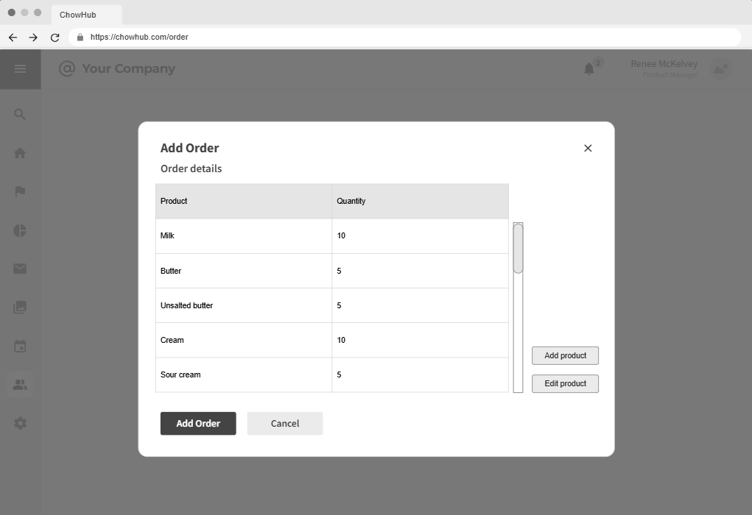
Supplier Management:
Restock Request to Supplier

